Slide 1
Analysing employee attrition
A data driven approach to retaining top talent

Slide 2
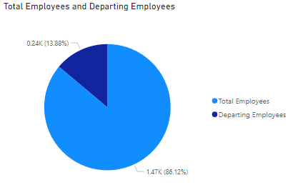
Introduction
The given HR Attrition dataset contains data about employee churn and factors contributing to it.
Attrition refers to departure of employees from the organization for any reason including resignation, termination, death or retirement.
The aim of the analysis is to discover trends and find the root cause why employees are leaving so as to prevent it in the future.

Slide 3
Lets Look At The Data
Attribute | Value
Age | 18 - 60
Attrition | Yes / No
Business Travel | Rarely/Frequently /None
Daily Rate | 100 - 1500
Department | HR/ Sales/ RnD
Distance from home | 1km - 30km
Education | 1 - 5
Attribute | Value
Job Level | 1 - 5
Job Role | MD / Manager etc
Job Satisfaction | 1 – 4
Marital Status | Married/Single/Divorced
Monthly Income | 1000 – 8000 INR
Monthly Rate | 2000 - 19000
No. of Companies Worked | 0 - 9
Education Field | Medical/ Technical etc
Employee Number | Primary key
Environment Satisfaction | 1 – 4
Gender | Male/ Female
Hourly rate | 30 - 100
Job Involvement | 1 - 4
Overtime | Yes / No
% Salary Hike | 11% – 25%
Performance Rating | 3 / 4
Relationship Satisfaction | 1 - 4
Stock Option Level | 0 - 3
Total Working Years | 0 - 40
Work Life Balance | 1 - 4
Years At Company | 0 - 40
Years Since Promotion | 0 – 15
Years w Curr Manager | 0 - 17

Slide 4
Basic Pre-processing
Handle Missing Values
Type Conversion - Conversion of Attrition column from variable type to text type
Removal of redundant columns/ duplicate rows - Over18, YearsSinceLastPromotion vs YearsInCurrentRole
Add Conditional Columns - Condensing DistanceFromHome into 3 categories – Far, Near, Very Far
Creating Measures - Measures can be used across all tables and make visualization easier.
Eg: Total Employees, Retained Employees, etc
Data Modelling - Condense the given table into many dimension tables which have one to many relationship with the provided table (fact table).
Eg: Distance table, age table, etc

Slide 5
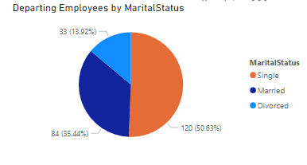
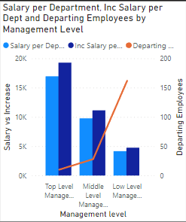
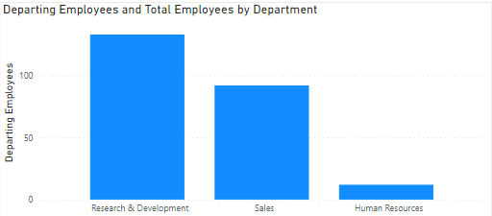
Factors that contribute to Attrition
Age
Job Level / Management Level
Department
Marital Status
Business Travel
Salary
Manager Switch
Stocks
Overtime
Training Time

Slide 6
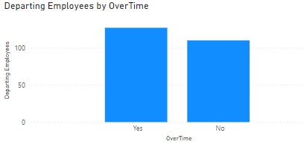
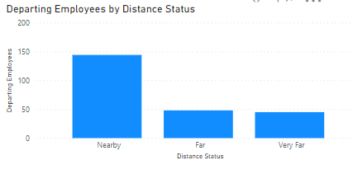
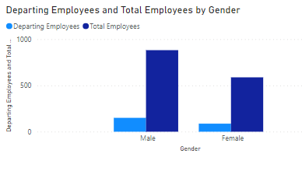
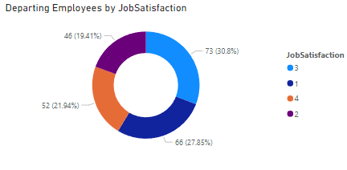
Factors that don't contribute to attrition
Gender
Distance From Home
Job Satisfaction
Job Involvement
Environment Satisfaction

Slide 7
Findings
Age
26-35 age bucket consisted of highest number of departing employees.
Low level management consists mostly of people from age range of 18-35.
Department
R&D is the department with most churn while HR has the least churn.
Sales has the highest churned to total employee ratio.
Distance
Employees who lived nearby were the ones who departed most across all categories.
Performance rating
Employees with low performance rating contributed to highest churn (200/237).
About 68% churned employees come from low level management and demonstrate less performance rating.

Slide 8
Findings
Overtime
Does not work life balance and job satisfaction.
Average salary of overtime and non overtime workers is almost same.
Marital Status
Bachelors in all age groups have the highest attrition dominating over 50% of the total.
Married employees in 26-35 age bucket also show significant churn.
Years with current manager
Attrition is higher among employees who were assigned to work with a new manger (35%).
Monthly Income and Increase
Higher income and increase among top level management.

Slide 9
Findings
Training Times per Year
Low and middle level management employees who were trained on an average of 2-3 times have highest attrition.
Stocks
Employees who were provided zero stocks showed higher churn
Job Satisfaction
About 25%-30% of departing employees gave their job satisfaction a rating of dissatisfied (1) on a scale of 1 to 4.
Experience
Candidates with experience less than 2 years show the most attrition.

Slide 10
Findings
Number of Companies Worked
The highest attrition rate was attributed to juniors who had previously worked in only one company.
Business Travel
Most employees who travelled came from low level management which shows high churn.
Salary among three business travel categories is comparable.
Salary Hike
Low level management with the lowest hike showed high churn.
Education
Employees with life sciences degree comprise majority of departing employees.

Slide 11
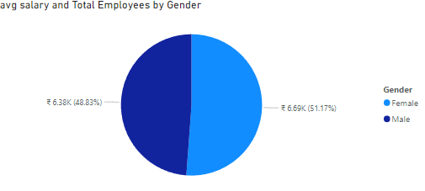
Some Shocking Facts!
Pay gap based on gender is non existent.
Distance from home does not determine churn rate in any form.
Employees leaving within one year of promotion is consistently high among all categories.
While the R&D department receives the highest total salary allocation, the average salary of this department across other departments is the lowest.
There is almost to no difference between average monthly wages of high and low performers.

Slide 12
Adjustments to reduce Attrition
Come up with more fresher friendly policies.
Implement work structure of low turnover companies in the departments with high churn.
Increase the salary increment percentage among the lower levels of management.
Collect constant feedback about the managers from employees working under them.
Promotion based on work as opposed to promotion based on years of work at company.
Allocate stocks to freshers to retain them.
Change training policies / keep the second , third training session less rigorous .

Slide 13
Thank You

